Slide 1




SAVE THE DATE:
The 23rd annual meeting of the European Pressure Ulcer Advisory Panel coming to Leeds, UK in 2023!
13-15 September 2023, Royal Armouries, Leeds
Local society collaborator
Notes:
Joao

Slide 2

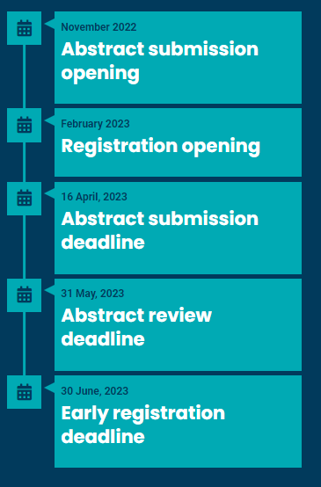
INNOVATIONS IN PRESSURE ULCER PREVENTION AND TREATMENT
Topics:
• Involving service users in pressure ulcer research and priorities
• Ensuring person centredness in pressure ulcer prevention
and treatment
• The role of risk assessment in pressure ulcer prevention
• New technologies to support care delivery for prevention
and treatment
• Surgical interventions for pressure ulcer treatment
• Challenges in pressure ulcer research
• Writing for scientific journals
... and much more
www.epuap2023.org
Notes:
Joao

Slide 3
EPUAP Annual Meeting means 3 days full of
Dedicated scientific programme
Key sessions reflecting actual topics and new cutting-edge technologies presented by key opinion leaders
More than 10 free paper sessions – abstract submission deadline in April!
Traditional focus on interactive hands-on workshops on various topics throughout the 3 days of the conference programme
Ample networking opportunities and great social events: relaxed welcome reception, conference dinner in beautiful settings, traditional pressure ulcer awareness walk, historical reenactment
Large and lively exhibition area
Industry workshops and symposia
See you in Leeds!
Notes:
Joao

